Slide 1

Employee Management System

Slide 2
Quick Introduction About me
Challa Rakesh Reddy
Aspiring Data Analyst Trainee, graduated in Information Technology from Sree Vidyanikethan Engineering College, Tirupati (2024). Passionate about data exploration, visualization, and storytelling, with expertise in Python, Pandas, SQL, Power BI, and web scraping.
Specialized in data-driven insights and optimizing workflows. Enthusiastic about corporate trends analysis, leveraging interactive visualizations, and refining problem-solving approaches.
Eager to apply technical skills and contribute to strategic data solutions in business analytics.
🔗 GitHub: https://github.com/ChallaRake
🔗 LinkedIn: https://www.linkedin.com/in/challa-rakesh-reddy/

Slide 3
Index
Objective of the Project
ER Diagram and schema explanation
Key analysis questions with SQL query results
Business Insights and Key Recommendations
Final Conclusion
Q&A Slide

Slide 4
Objective of the Project
The objective of this project is to design and implement an Employee Management System that efficiently stores and manages employee-related data within an organization. The system needs to track various aspects of employee information, including personal details, job roles, salary structures, qualifications, leave records, and payroll data. The system should ensure the integrity and consistency of data by using relational tables with appropriate foreign keys and cascading actions.
The system should allow for easy management and querying of employee data, providing insights such as payroll calculation, leave tracking, and department-specific job roles. The goal is to streamline HR operations, ensuring that all relevant employee data is accessible and accurately updated across different modules.

Slide 5
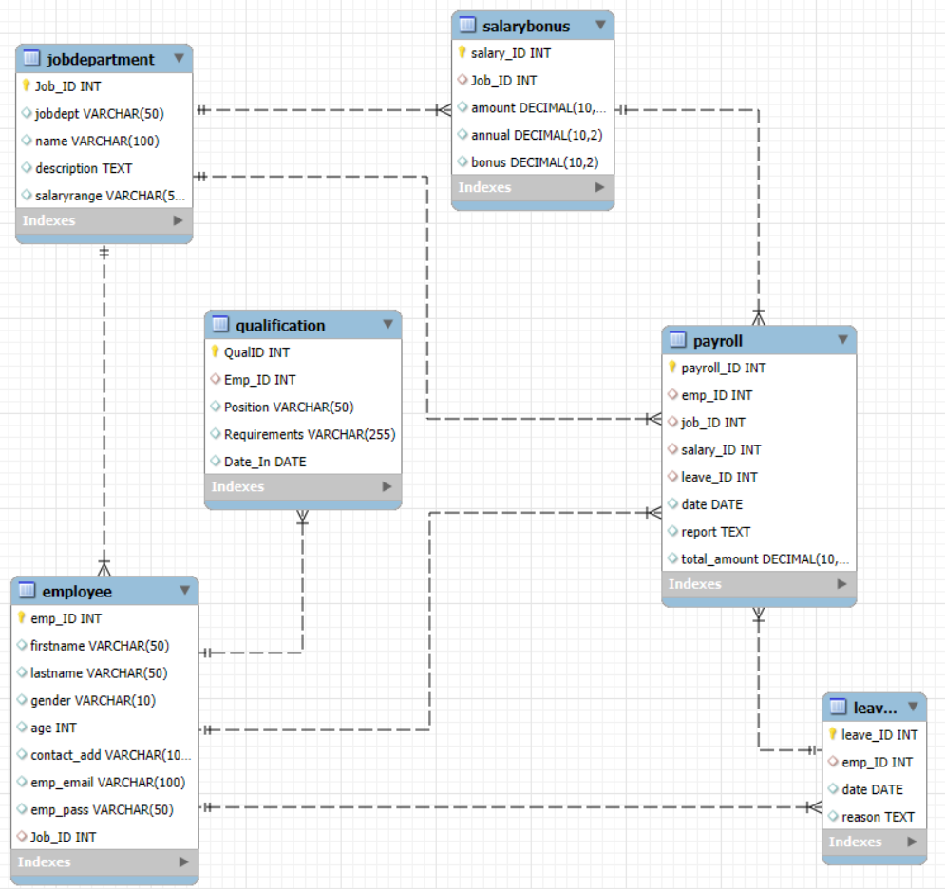
ER Diagram

Slide 6
Schema Explanation
Table name | Description
JobDepartment | Stores job roles, departments, and related salary ranges
SalaryBonus | Contains salary, bonus, and annual pay linked to specific job roles.
Employee | Maintains personal, contact, and login details of all employees.
Qualification | Records qualifications and required skills for employee job positions.
Leaves | Tracks employee leave records with reasons and dates.
Payroll | Combines employee, job, salary, and leave data to calculate net payments.

Slide 7

Key Analysis
1. EMPLOYEE INSIGHTS
1. How many unique employees are currently in the system?
Result:

Slide 8
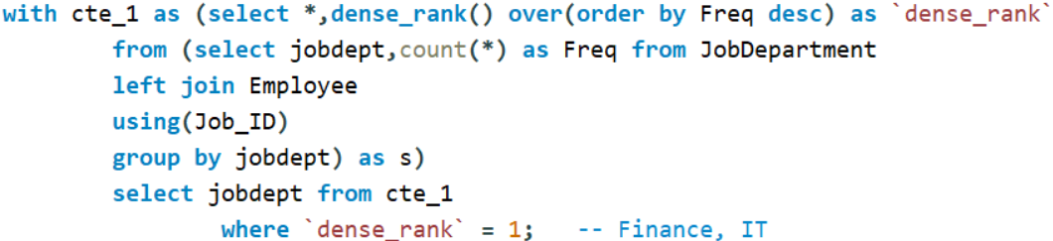

2. Which departments have the highest number of employees?
Result:

Slide 9
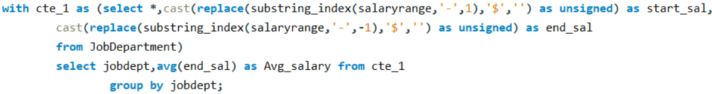
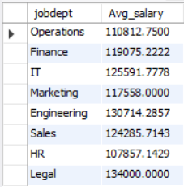
3. What is the average salary per department?
Result:

Slide 10
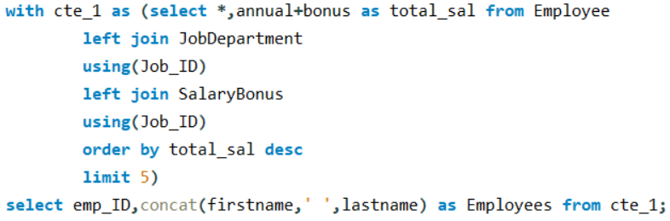
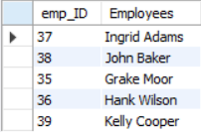
4. Who are the top 5 highest-paid employees?
Result:

Slide 11
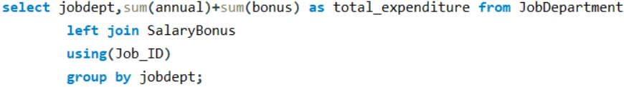
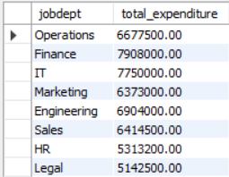
5. What is the total salary expenditure across the company?
Result:

Slide 12
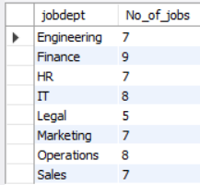
2. JOB ROLE AND DEPARTMENT ANALYSIS
1. How many different job roles exist in each department?
Result:

Slide 13
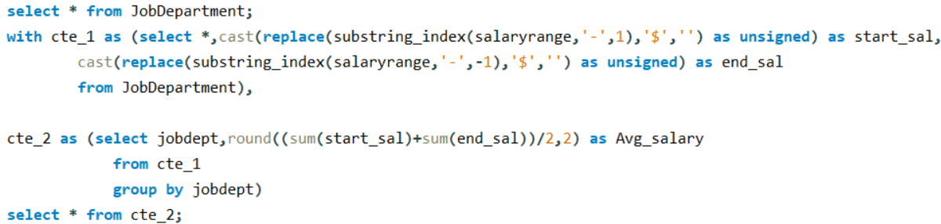
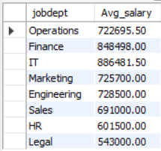
2. What is the average salary range per department?
Result:

Slide 14
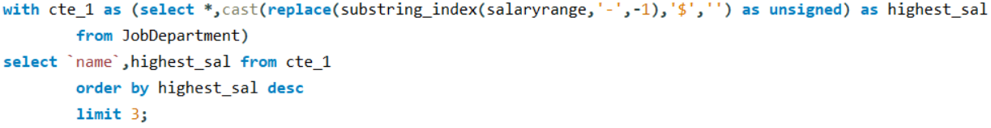

3. Which job roles offer the highest salary?
Result:

Slide 15
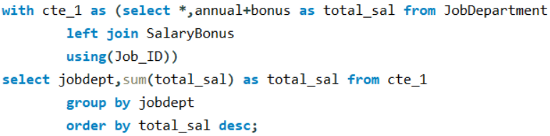
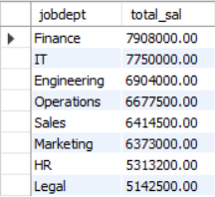
4. Which departments have the highest total salary allocation?
Result:

Slide 16


3. LEAVE AND ABSENCE PATTERNS
1. Which year had the most employees taking leaves?
Result:

Slide 17
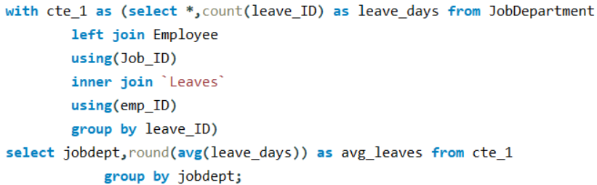
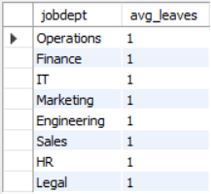
2. What is the average number of leave days taken by its employees per department?
Result:

Slide 18
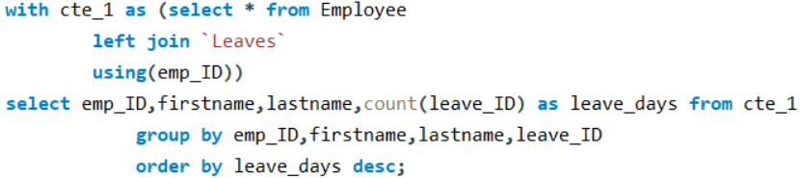
3. Which employees have taken the most leaves?
Result: Every employee took one leave at most.

Slide 19
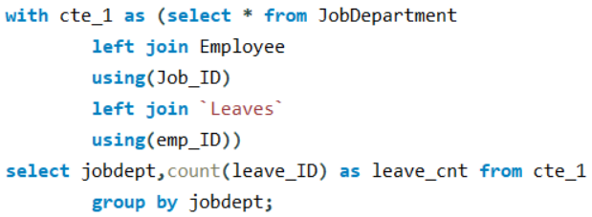
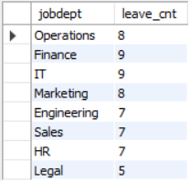
4. What is the total number of leave days taken company-wide?
Result:

Slide 20

5. How do leave days correlate with payroll amounts?
Result: Based on the common column 'leave_ID' the leave days are correlated with 'payroll' amounts. Due to this 'leave_ID' the payroll of every month will be decided for the employees.

Slide 21

4.PAYROLL AND COMPENSATION ANALYSIS
1. What is the total monthly payroll processed?
Result:

Slide 22
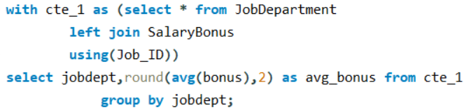
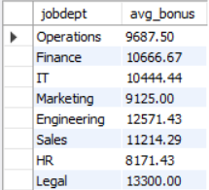
2. What is the average bonus given per department?
Result:

Slide 23
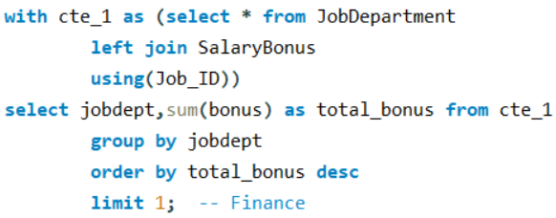

3. Which department receives the highest total bonuses?
Result:

Slide 24

4. What is the average value of total_amount after considering leave deductions?
Result:

Slide 25
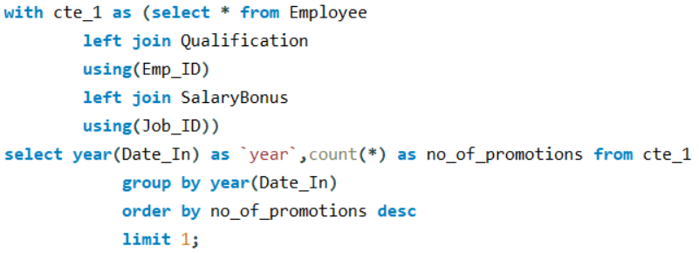

5. EMPLOYEE PERFORMANCE AND GROWTH
1. Which year had the highest number of employee promotions?
Result:

Slide 26
Business Insights
The Finance department has the highest total salary allocation and bonuses, indicating it is a priority investment for the organization.
Employees take only one leave at most, and department-wide totals are relatively low. This reflects strong workforce attendance but may indicate employees are overworked or discouraged from taking leaves.
Payroll is stable, and leave deductions have limited impact on salary amounts.
12 promotions in 2020, the highest across years, reflecting strong career growth opportunities during that period.

Slide 27
Key Recommendations
Balance compensation by ensuring fair bonus distribution across departments.
Encourage healthy leave usage to improve employee well-being and retention.
Revitalize career growth plans by reassessing promotion strategies.
Optimize payroll policies to refine leave encashment and retention strategies.

Slide 28
Final Conclusion
The company has maintained financial stability while ensuring structured employee management. Payroll expenses and bonuses reflect strong investment in workforce growth, but leave patterns suggest potential concerns regarding employee well-being. Career progression saw a peak in 2020, indicating past opportunities for advancement that may need renewed focus. To ensure long-term success, a balance between financial efficiency and employee satisfaction is crucial, driving both productivity and retention.

Slide 29
Any
Questions?

Slide 30

THANK YOU

